Slide 1




CSE299.3
FALL 2026/NSU
Group 02
SIDE-QUEST
Project Proposal
A Social Hangout Planning and Friend Interaction Application
Facuty Advisor
Dr.Mohammad Shifat-E Rabbi
Group 02
ZARIFA RAHMAN
TAZREAN TASNEEM
TAHMIDATUL AYESHA ASHA
SOUMIK SIKDER
TANZIM AHAMAD

Slide 2


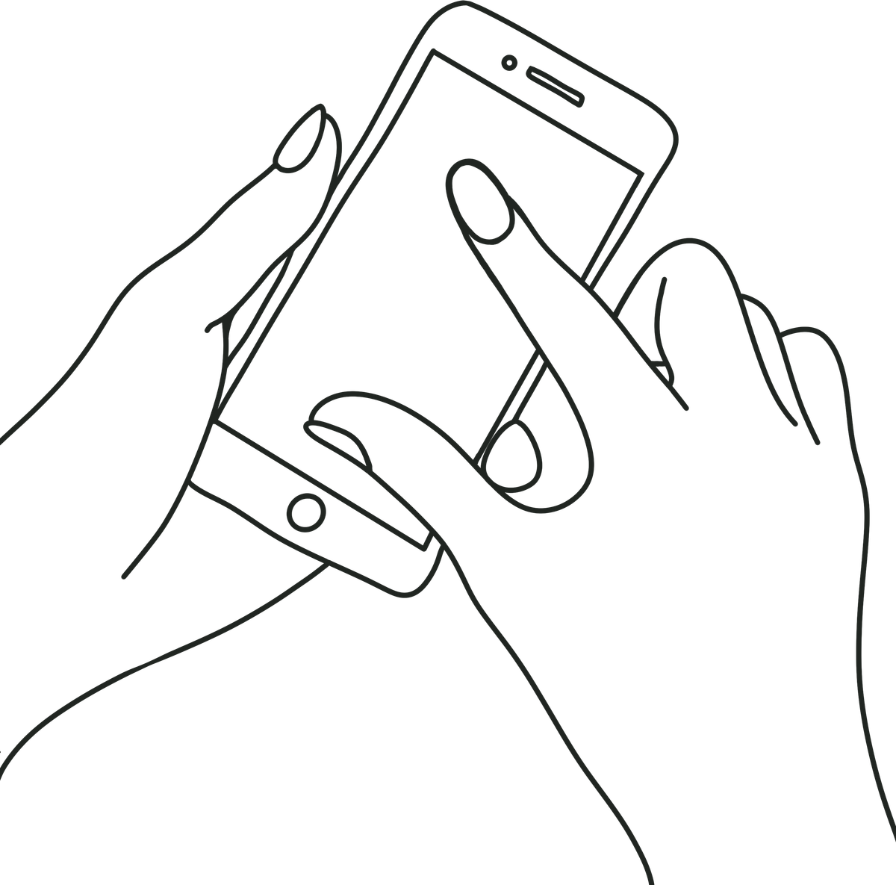
SIDEQUEST: THE IDEA
SideQuest is a social chatting application designed for group hangout planning.
The idea was developed to combine normal group communication with an organized planning process because planning group activities can become difficult when members have different preferences and suggestions.
The project aims to make group decision-making more organized, convenient, and collaborative.
Group 02
ZARIFA RAHMAN
TAZREAN TASNEEM
TAHMIDATUL AYESHA ASHA
SOUMIK SIKDER
TANZIM AHAMAD

Slide 3



THE KEY INNOVATION
WHY
SIDEQUEST
THE PROJECT PROVIDES A FOUNDATION FOR FUTURE DEVELOPMENT OF INTEGRATED SOCIAL AND PLANNING FEATURES, ALLOWING USERS TO MANAGE CHATTING, PLANNING, AND DECISION-MAKING IN ONE PLACE INSTEAD OF SWITCHING BETWEEN DIFFERENT APPLICATIONS.
Group 02
ZARIFA RAHMAN
TAZREAN TASNEEM
TAHMIDATUL AYESHA ASHA
SOUMIK SIKDER
TANZIM AHAMAD

Slide 4


WHAT’S SO SPECIAL THAN AN USUAL SOCIAL MEDIA?
The application supports the basic features of a social communication platform, including private messaging, group messaging, friend management, and user profiles.
It allows users to communicate and maintain their social connections within the application.
SIDEQUEST PROVIDES A
STRUCTURED SYSTEM
FOR CHATTING, PLANNING AND
DECIDING GROUP
HANGOUTS
WITHIN THE SAME APP
SPECIALITY
Group 02
ZARIFA RAHMAN
TAZREAN TASNEEM
TAHMIDATUL AYESHA ASHA
SOUMIK SIKDER
TANZIM AHAMAD

Slide 5



SIDEQUEST
PLANNING
This is the main idea of the project. Users will be able to create a SideQuest planning session within a group conversation
01.
A SideQuest can contain
either a single activity or
multiple activities.
Eg.
Movie->Lunch->Desert
02.
Group 02
ZARIFA RAHMAN
TAZREAN TASNEEM
TAHMIDATUL AYESHA ASHA
SOUMIK SIKDER
TANZIM AHAMAD

Slide 6




SOCIAL GAMES & OVERALL EXPERIENCE
  FRIEND TRIVIA ALLOWS MEMBERS TO PREDICT ANSWERS ABOUT EACH OTHER AND RECEIVE SCORES.
  WOULD YOU RATHER ALLOWS MEMBERS TO CHOOSE BETWEEN TWO OPTIONS AND VIEW THE GROUP RESULTS.
The System also contains 2 small social games which can be accessed from the group conversations.
  THESE GAMES PROVIDE ADDITIONAL SOCIAL INTERACTION WITHIN GROUP CONVERSATIONS.
  OVERALL, SIDEQUEST COMBINES CHATTING, PLANNING, DECISION-MAKING, AND SOCIAL INTERACTION IN ONE APPLICATION.
Group 02
ZARIFA RAHMAN
TAZREAN TASNEEM
TAHMIDATUL AYESHA ASHA
SOUMIK SIKDER
TANZIM AHAMAD

Slide 7
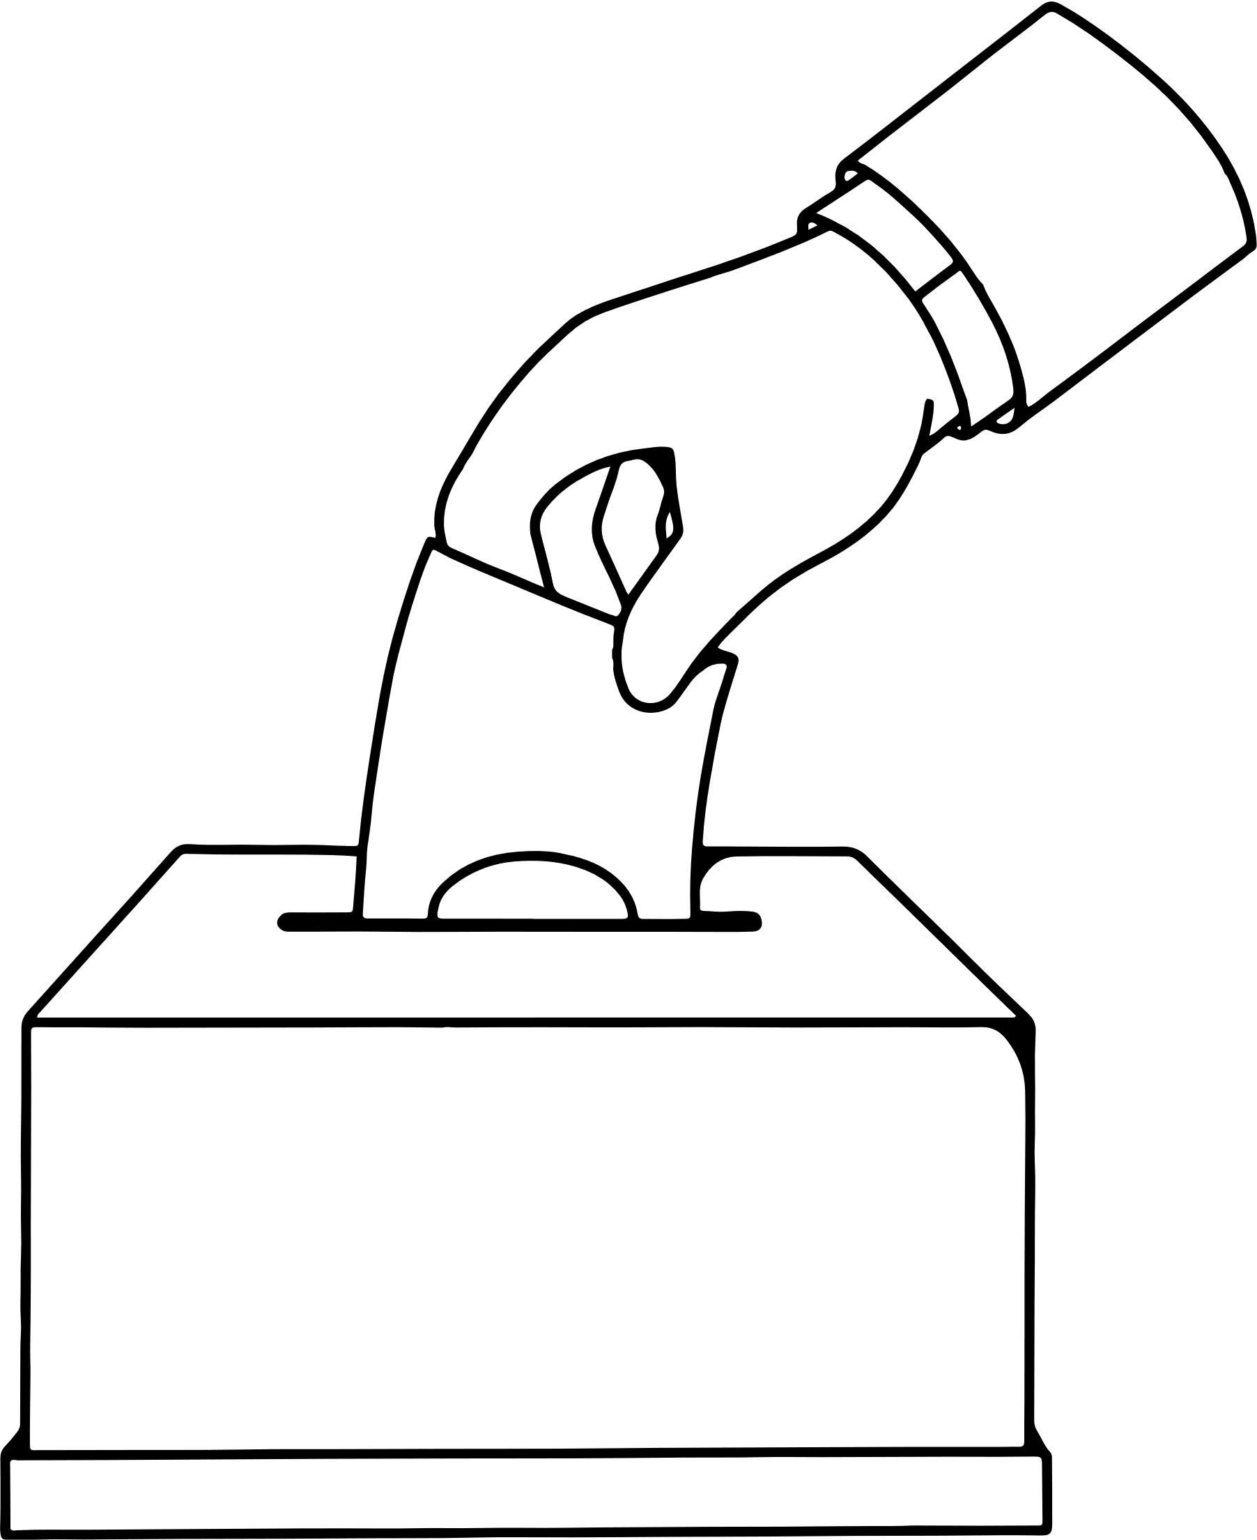


PREFERNCES & VOTING
  Different planning preferences can be specified, including budget, activity type, cuisine, location, and available time.
  Possible hangout options are added or presented within the SideQuest session.
  Group members can vote for their preferred choices.
  The voting process helps the group narrow down options and reach a final decision.
Group 02
ZARIFA RAHMAN
TAZREAN TASNEEM
TAHMIDATUL AYESHA ASHA
SOUMIK SIKDER
TANZIM AHAMAD

Slide 8



FINAL HANGOUT PLAN
  THE SELECTED ACTIVITIES AND OPTIONS ARE COMBINED INTO AN ORGANIZED FINAL HANGOUT PLAN.
  THE FINAL PLAN CONTAINS THE ACTIVITIES, LOCATIONS, DATE, TIME, PARTICIPANTS, AND ESTIMATED BUDGET.
  PREVIOUS SIDEQUEST PLANS ARE MAINTAINED FOR FUTURE REFERENCE.
  THIS ALLOWS THE GROUP TO MOVE FROM INITIAL DISCUSSION TO A CLEAR FINAL PLAN.
Group 02
ZARIFA RAHMAN
TAZREAN TASNEEM
TAHMIDATUL AYESHA ASHA
SOUMIK SIKDER
TANZIM AHAMAD

Slide 9
THANK YOU!
Group 02
ZARIFA RAHMAN
TAZREAN TASNEEM
TAHMIDATUL AYESHA ASHA
SOUMIK SIKDER
TANZIM AHAMAD

